Slide 1

A Cognitive Vision-Enabled Pharmaceutical Intelligence Framework for Multimodal Prescription Analysis

Slide 2
1. INTRODUCTION
Pharmacies traditionally rely on manual prescription processing and inventory tracking, which can lead to errors, delays, and inefficiencies. With increasing prescription volumes and growing demand for faster healthcare services, intelligent digital solutions are required to improve pharmacy operations.
This project proposes a Pharmaceutical Intelligence that integrates OCR-based prescription analysis, real-time inventory monitoring, machine learning demand forecasting, and an AI chatbot. The system aims to reduce manual errors, improve stock management, and enhance pharmacy service efficiency.

Slide 3
2. MOTIVATION
• Manual prescription handling often leads to reading errors and incorrect medicine dispensing. • Traditional inventory systems fail to track real-time stock levels and expiry dates accurately. • Growing customer demand increases workload and pressure on pharmacists. • Lack of forecasting causes medicine shortages or excess wastage. • Absence of digital assistance reduces operational efficiency and service quality. • Intelligent automation can improve accuracy, speed, and reliability in pharmacy operations.

Slide 4
3. CONCERNS IDENTIFIED FROM BASE PAPERS
• Most existing pharmacy systems are rule-based and lack intelligent, adaptive decision-making. • Limited integration of OCR with real-time inventory and dispensing workflows. • Absence of machine learning–based demand forecasting in many proposed systems. • Lack of pharmacy-specific chatbot support for customer interaction and guidance. • Scalability issues when handling multi-branch or high-volume pharmacy operations. • Insufficient focus on data security, privacy, and regulatory compliance in academic solutions.

Slide 5
LITERATURE REVIEW
S. No | Title | Authors | Year | Methodology | Pros | Cons
1 | Pharmacy Management System using Artificial Intelligence | Nishane, O., Ajankar, V. | 2025 | AI-based automation with rule-based prescription processing | Reduces manual errors, improves automation | Rule-based, not scalable, no ML forecasting or chatbot
2 | Digital Evolution in Pharmacy Practice | Ogundipe, A., Sim, T. F., Emmerton, L. | 2025 | Study on digital transformation trends and workflows | Provides strategic and policy-level insights | No technical implementation
3 | Digital Healthcare Services in Community Pharmacies (Pneumoscope™) | Backes, C., et al. | 2025 | Pilot study of digital consultation tools | Validates digital readiness | Small sample size, no inventory or OCR
4 | DSCSA-Compliant Real-Time Inventory Management | Karvannan, R. | 2025 | Compliance-based real-time inventory tracking | Ensures traceability and regulation | No OCR, AI decision support, or forecasting
5 | AWS Cloud for Pharmacy Cashier Management | Kurniawan, H., Handoko, L. B., Aldo, V. | 2025 | Cloud migration of cashier systems | Improves performance and security | Limited to billing operations

Slide 6
LITERATURE REVIEW
S. No | Title | Authors | Year | Methodology | Pros | Cons
6 | Semi-Supervised Learning for Classifying Drug Attributes | Pan, Q., Liu, Y., Wei, S. | 2025 | Semi-supervised ML for medicine attribute classification | Reduces labeling cost, good accuracy | Not integrated with inventory or dispensing
7 | Scalable Cloud Architecture for Pharmacy Inventory | Karvannan, R. | 2025 | Cloud-based multi-branch inventory synchronization | Improves consistency across branches | No demand forecasting or OCR
8 | AI Detection of Persistent vs Non-Persistent Medications | Abasa, S., et al. | 2025 | ML models for medication persistence classification | Enhances pharmaceutical safety | Limited dataset, no live system validation
9 | Pharmacist-Led Digital Health Interventions for Diabetes | Christy, A., et al. | 2025 | Review of telehealth and digital care models | Improves patient engagement | Focuses on healthcare, not pharmacy operations
10 | Digital Health Literacy to Reduce Antibiotic Misuse | Lawal, O., et al. | 2025 | Analysis of digital education platforms | Supports public health awareness | No automation or system-level implementation

Slide 7
5. IDEA FORMULATION FROM LITERATURE REVIEW
• Existing studies highlight the need for intelligent automation beyond rule-based pharmacy systems. • Literature reveals a lack of integrated solutions combining OCR, inventory control, and forecasting. • Identified gaps motivate the use of machine learning for demand prediction and decision support. • Absence of real-time customer interaction systems leads to poor service efficiency. • Pharmacy-specific chatbots can enhance accessibility and user assistance. • These insights led to the design of an integrated, AI-driven digital pharmacy management system.

Slide 8
6. ABSTRACT
The Digital Pharmacy Management System is designed to automate prescription processing, streamline inventory management, and support data-driven pharmacy operations. The system utilizes OCR-based extraction to accurately interpret prescriptions, real-time inventory updates to monitor stock levels, and machine learning techniques to forecast medicine demand. Additionally, a pharmacy-specific chatbot assists users with medicine-related queries, while analytical dashboards help pharmacists track sales trends and operational efficiency. By digitizing traditional workflows, the system minimizes human errors, reduces medicine shortages and wastage, and enhances service accuracy, accessibility, and reliability in modern pharmacy environments.

Slide 9
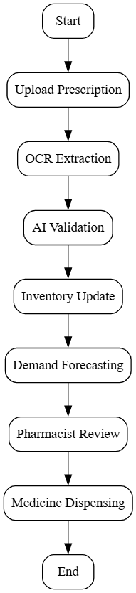
FLOWCHART
• User uploads prescription through the system interface. • OCR extracts medicine details and validates data using AI. • Inventory is updated and demand forecasting is performed. • Pharmacist reviews results and completes medicine dispensing.

Slide 10
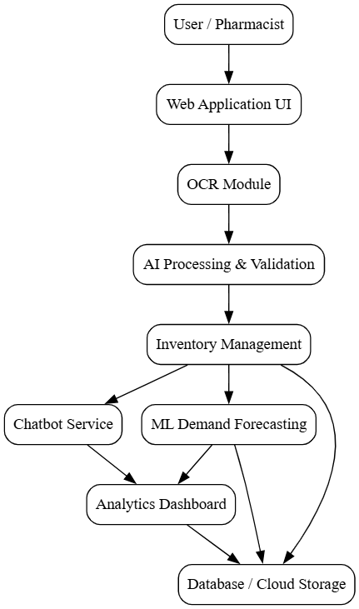
SYSTEM ARCHITECTURE
• User interacts with the system through a web-based pharmacy interface. • Prescription images are processed using OCR and AI modules for data extraction. • Backend services manage inventory, forecasting, chatbot, and analytics. • Database and cloud services store prescriptions, stock, sales, and reports securely.

Slide 11
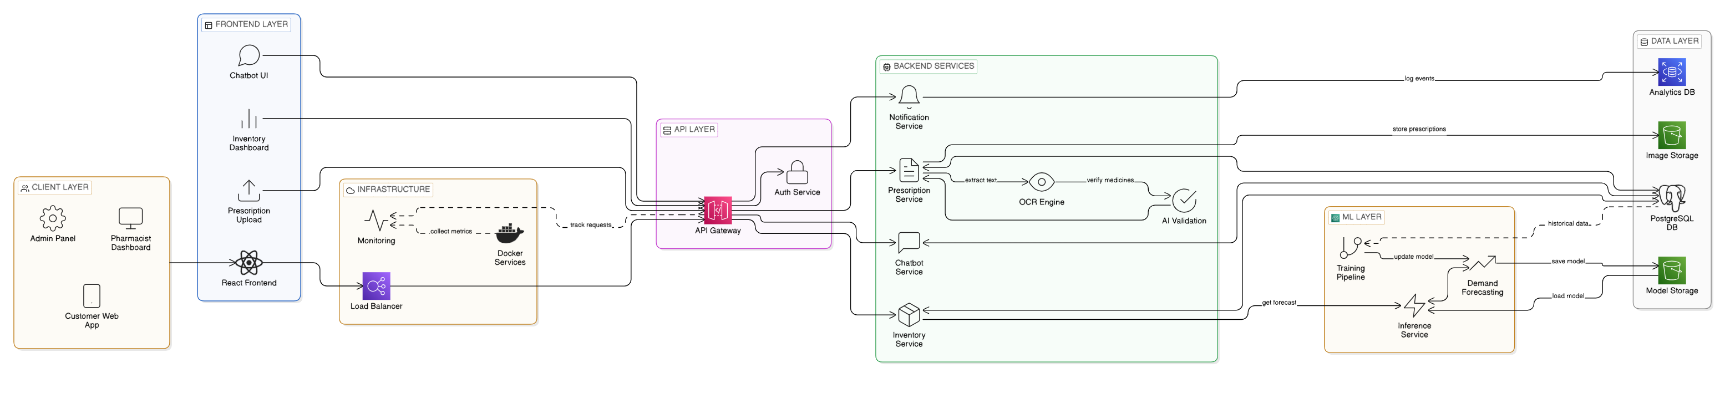

Slide 12
Database — 4 Tables
users — stores username, bcrypt-hashed password, and role (ADMIN or PHARMACIST)
medicines — the inventory catalog. Stores name, manufacturer, batch number, expiry date, quantity, price, description
sales — every transaction. Linked to medicines via foreign key. Stores quantity sold, sale date, total price
prescriptions — uploaded prescription records. Stores the image path, the AI-extracted data as JSONB, and a status (Pending/Processed)

Slide 13
Features 1. Authentication
When a user logs in, the backend checks the username, compares the password using bcrypt, and if valid, returns a JWT token that expires in 24 hours. Every subsequent API call includes this token. The authMiddleware extracts and verifies it. There's also an authorize() function that checks the user's role — so an ADMIN and a PHARMACIST get different access levels.
ADMIN → full CRUD on everything PHARMACIST → can view inventory and process prescriptions, but cannot add/edit/delete medicines

Slide 14
2. Inventory Management
This is the core module. The inventory page shows all medicines in a table. If you're an Admin, you see buttons to Add, Edit, Delete. If you're a Pharmacist, you see a "View-Only Access" banner — the add/edit/delete buttons don't even render.
There's also CSV bulk import — an admin can upload a CSV file with multiple medicines and they all get added in one shot. The column headers are matched case-insensitively so the format is flexible.
The backend has 6 endpoints for this:
GET all medicines
GET one medicine by ID
POST to create
PUT to update
DELETE to remove
POST /import for CSV upload

Slide 15
3. Sales
The Sales page has two sections.
Point of Sale — you search for a medicine by name or ID, it auto-fills the price, you enter the quantity, and hit record. The backend doesn't just save the sale — it also automatically deducts the quantity from inventory. So stock is always accurate after every sale.
Demand Forecast — you pick a medicine, and the system pulls its sales history and runs a linear regression to predict the next 7 days of demand. This is displayed as a line chart with historical data and a forecast line. This is the ML component of the project.

Slide 16
4. AI Prescription Processing
This is the most technically impressive feature. A pharmacist uploads a prescription image or PDF. The backend receives it via Multer, converts it to base64, and sends it to the Google Gemini Vision API with a prompt asking it to extract the patient name, list of medicines, and dosages.
Gemini returns structured JSON. That JSON gets saved in the prescriptions table in a JSONB column. The status is set to Processed. If Gemini fails for any reason, the status stays Pending and the error is noted.
On the frontend, the pharmacist can see all uploaded prescriptions, click on any one, and see the extracted data in a formatted panel — patient name, medicines, dosages — all pulled automatically from the image without manual typing.

Slide 17
5. AI Chat Assistant
There's a chat page where any logged-in user can ask questions. The backend calls Gemini with the user's message — but crucially, it injects the live inventory data into the prompt context. So the AI can answer questions like "What's the price of Paracetamol?" or "Which medicines are low on stock?" with real, current data. Responses are rendered in Markdown.

Slide 18
6. Dashboard
The landing page after login. Shows three stat cards:
Today's Revenue — sum of all sales today
Prescriptions Processed Today — count of prescriptions processed today
Low Stock Alert — count of medicines with quantity below 20 units
Plus a bar chart showing revenue trend for the last 7 days using Chart.js.

Slide 19
Security features
bcrypt for password hashing — plain text passwords are never stored
JWT for stateless authentication — no sessions, scales well
Helmet — sets secure HTTP headers automatically
express-rate-limit — 100 requests per 15 minutes per IP on all /api routes, prevents abuse
CORS — only allowed origins can call the API
express-validator — input validation on auth routes, rejects malformed requests early
Role-based authorization — middleware checks role on every sensitive endpoint, not just the UI

Slide 20
9. SUSTAINABLE DEVELOPMENT GOALS (SDG)
SDG 3: Good Health and Well-Being
• Improves accuracy in medicine dispensing through automated prescription processing. • Reduces medication errors caused by manual interpretation. • Ensures timely availability of essential medicines. • Minimizes risks from expired or near-expiry drugs. • Enhances pharmacist decision-making using analytics. • Supports faster and safer patient service delivery. • Promotes reliable access to healthcare services. • Strengthens overall public health outcomes through digital innovation.

Slide 21
11. RESULTS AND DISCUSSION
• The system successfully automates prescription processing using OCR and AI, significantly reducing manual intervention and minimizing errors in medicine identification and dispensing compared to traditional pharmacy workflows.
• Real-time inventory management combined with machine learning–based demand forecasting improves stock accuracy, reduces medicine shortages, and minimizes wastage caused by overstocking or expiry.
• The integrated chatbot and analytics dashboard enhance customer interaction and support pharmacists in data-driven decision-making, leading to improved operational efficiency and overall service quality.

Slide 22
12. TIMELINE
Week | 1 | 2 | 3 | 4 | 5 | 6 | 7 | 8 | 9 | 10 | 11 | 12
Major Activities
Literature review
Frontend setup
Backend API’s building
Integration of frontend & backend
Testing
Documents

Slide 23
13. CONCLUSION
• The Digital Pharmacy Management System effectively automates prescription processing and inventory management using OCR and AI technologies, reducing manual errors and improving operational accuracy.
• Integration of machine learning–based demand forecasting and real-time stock monitoring ensures better inventory control, minimizes medicine shortages, and reduces wastage.
• The proposed system enhances pharmacy efficiency, supports informed decision-making, and contributes to safer, faster, and more reliable healthcare service delivery.

Slide 24
14. REFERENCES
O. Nishane and V. Ajankar, “Pharmacy Management System using Artificial Intelligence,” in Proc. 2025 Int. Conf. on Machine Learning and Autonomous Systems (ICMLAS), IEEE, Mar. 2025, pp. 1266–1271.
A. Ogundipe, T. F. Sim, and L. Emmerton, “Prescription for digital evolution: Transformative recommendations for pharmacy practice in the digital age,” Journal of Pharmacy Practice, vol. 38, no. 2, pp. 237–248, 2025.
C. Backes et al., “Digital healthcare services in community pharmacies in Switzerland: Pharmacist and patient acceptability, and pharmacist readiness – The Pneumoscope™ pilot study,” Digital Health, vol. 11, 2025.
R. Karvannan, “Architecting DSCSA-compliant systems for real-time inventory management in high-volume retail pharmacy networks,” Int. J. of Research Publications in Engineering, Technology and Management, vol. 8, no. 2, pp. 11772–11777, 2025.
H. Kurniawan, L. B. Handoko, and V. Aldo, “The implementation of AWS cloud technology to enhance the performance and security of the pharmacy cashier management system,” INOVTEK Polbeng – Seri Informatika, vol. 10, no. 1, pp. 73–86, 2025.

Slide 25
References
Q. Pan, Y. Liu, and S. Wei, “A semi-supervised learning approach to classify drug attributes in a pharmacy management database: A STROBE-compliant study,” Medicine, vol. 104, no. 10, e41601, 2025.
R. Karvannan, “Scalable cloud architecture for synchronizing pharmacy inventory between central and local systems,” Int. J. of Research Publications in Engineering, Technology and Management, vol. 8, no. 1, pp. 11810–11815, 2025.
S. Abasa, F. Aziz, P. Ishak, and J. Jeffry, “Detection of persistent vs non-persistent medications in pharmacy using artificial intelligence,” Journal of System and Computer Engineering, vol. 6, no. 1, pp. 137–143, 2025.
A. Christy, F. Fernanda, W. N. Insani, and R. Abdulah, “Pharmacist-led digital health interventions for patients with diabetes: A systematic review,” Journal of Multidisciplinary Healthcare, pp. 101–112, 2025.
O. Lawal et al., “A review on usage of digital health literacy to combat antibiotic misuse and misinformation in Nigeria,” Journal of Pharma Insights and Research, vol. 3, no. 2, pp. 258–269, 2025.

Slide 26
10. IMPLEMENTATION & RESULT IMAGES

Slide 27
10. IMPLEMENTATION & RESULT IMAGES

Slide 28
10. IMPLEMENTATION & RESULT IMAGES

